Slide 1
What’s New & Cool in Surgery: Where’s the Scar?
Richard D. Bloomberg, MD, FACS, FRCSC
Surgical Associates of WNY
October 2014

Slide 2
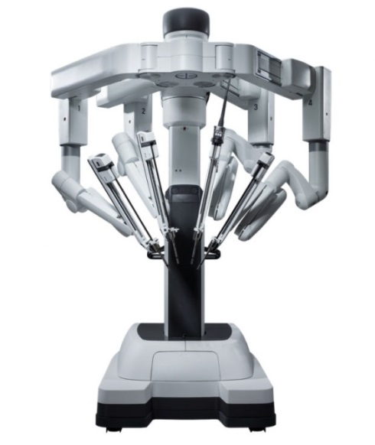

Agenda
Laparoscopic/Minimally Invasive Surgery
Single Port Access Surgery (SILSTM)
Robotic-assisted surgery (da Vinci Robot)
Natural Orifice Translumenal Endoscopic Surgery (NOTES)
Minimally Invasive Hemorrhoid Treatment

Slide 3
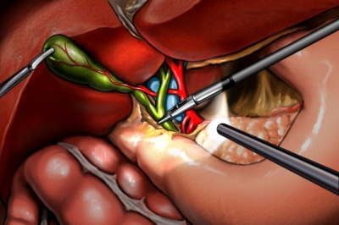
Laparoscopic/Minimally Invasive Surgery
First lap cholecystectomy in the US: 1988
Now, almost every organ is accessible
>90% of cholecystectomies are done laparoscopically

Slide 4
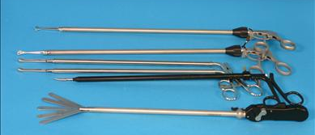
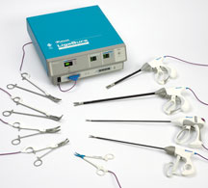
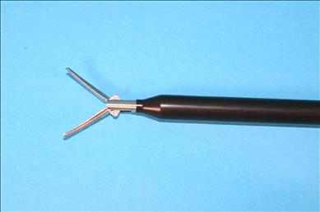
Laparoscopic Instruments
Graspers
Sheers
Cautery
Harmonic (ultrasound)
LigaSure
Staplers
Suturing devices

Slide 5
Benefits of Laparoscopic Surgery
Cosmetic
Less pain
Speedier recovery/shorter hospital stay
Fewer adhesions (scar tissue)
Fewer wound infections
Fewer post-operative complications
Photographs/video/magnified view

Slide 6
General Surgery MIS Procedures We Offer
Diagnostic laparoscopy (chronic pain)
Lap cholecystectomy (gallbladder)
Lap appendectomy (appendix)
Lap inguinal hernia repair (groin hernia)
Lap ventral/incisional hernia repair

Slide 7
General Surgery MIS Procedures We Offer
Lap gastric surgery (stomach)
Lap colon surgery (benign or malignant)
Lap small bowel surgery
Lap splenectomy (spleen removal)
Lap adrenalectomy (adrenal removal)
Lap distal pancreatectomy (pancreas)

Slide 8
General Surgery MIS Procedures We Offer
Lap Nissen fundoplication (anti-reflux)
Lap esophageal myotomy (achalasia)
Lap paraesophageal hernia repair
Lap cancer staging/lymph node biopsy
Lap emergency surgery (bowel obstruction, ulcer, trauma)

Slide 9
YES!
But, can this type of surgery be done with only one incision?

Slide 10
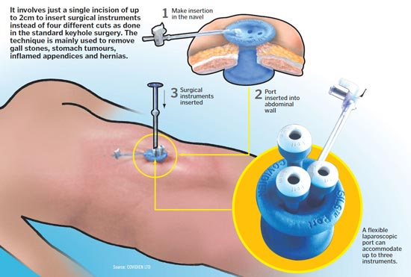
Single Port Access Surgery

Slide 11
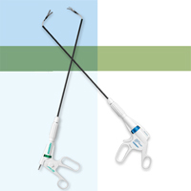
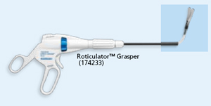
Single Port Access Surgery
Instruments: articulate

Slide 12
Single Port Access Surgery
Advantages
Cosmetic: one incision! Basically scarless
Less pain
Quicker recovery
Disadvantages
Takes longer
Higher cost
Restricted degree of movement (tough on surgeon)

Slide 13
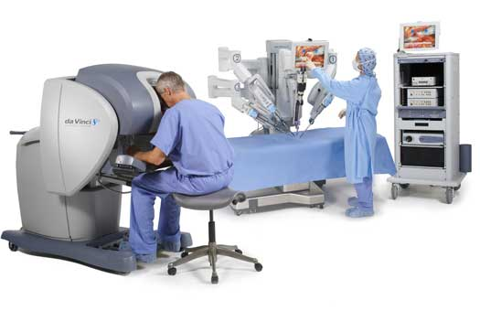
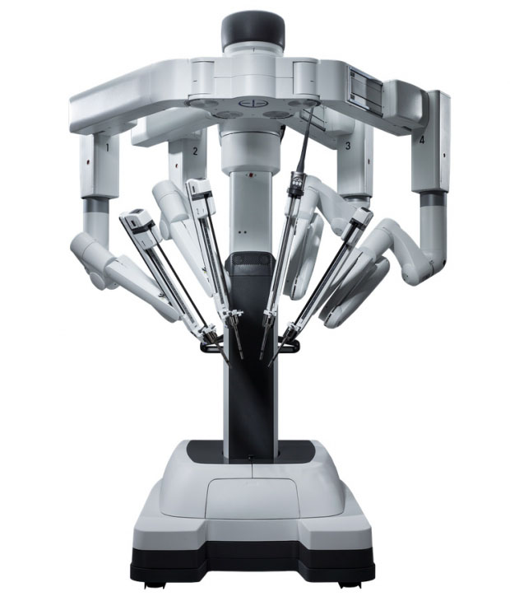
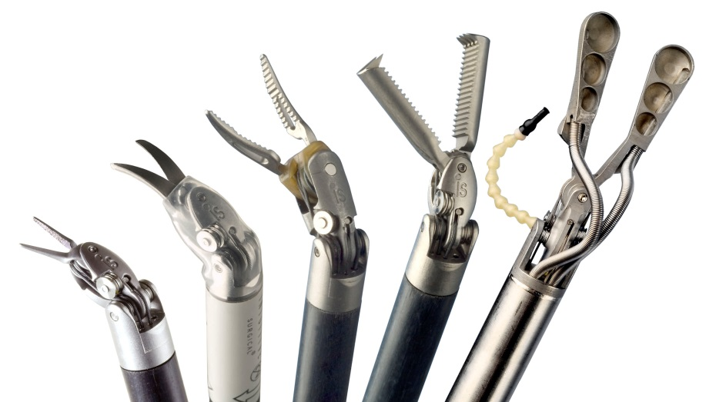
Robotic Surgery

Slide 14
The Evolution of Robotic Surgery
World’s first surgical robot, 1983
1st robotic cholecystectomy using PUMA, 1987
da Vinci Surgical Robot clears FDA, 1999-2000
1st robotic-assisted heart bypass in USA, 1999
Remote robotic chole USA to France, 2001
Robotic-assisted kidney transplant, 2009
da Vinci Single-Site Platform FDA-approved, 2011

Slide 15
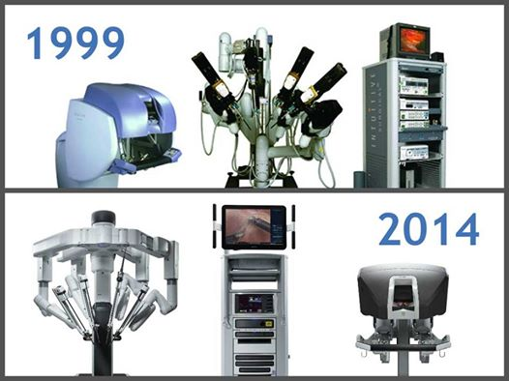
The Evolution of Robotic Surgery

Slide 16

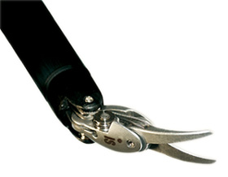
Robotic Surgery
Benefits
More precise/range of motion
3D vision/magnified
Less bleeding
More comfortable for surgeon
Can be done remotely
Disadvantages
Lack of haptics
Cost? (Myth…)
Long set-up/procedure time
Higher learning curve

Slide 17
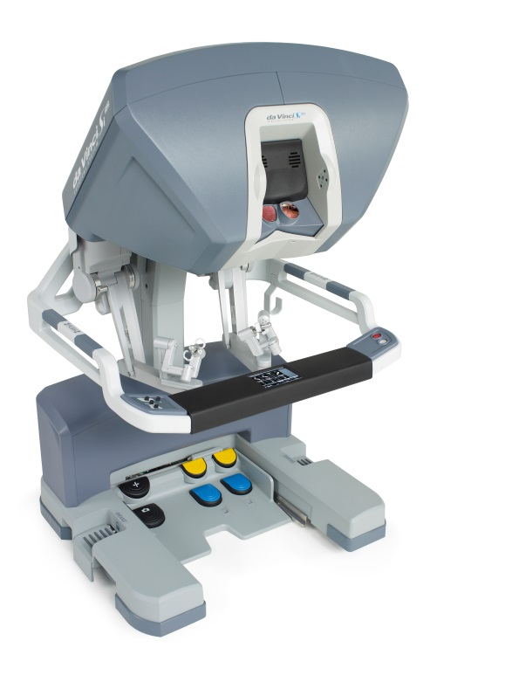
Robotic Surgery
Commonly used for
Urology (prostatectomy)
Cardiac (heart surgery)
Gynecology (hysterectomy)
Was previously thought to be less useful in general surgery…UNTIL NOW!

Slide 18
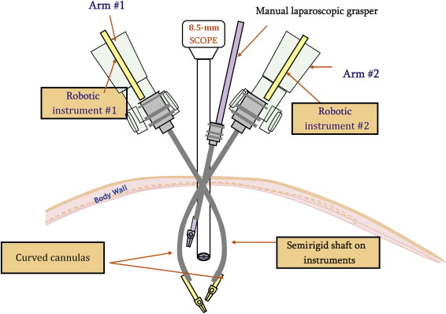
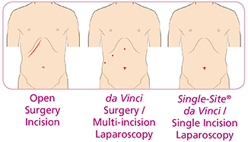
Single-Site Robotic Surgery
Added benefits: virtually scarless & high patient satisfaction

Slide 19
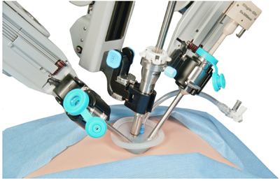
Single-Site Robotic Surgery
Approved for
Cholecystectomy, 2011
Hysterectomy, 2013

Slide 20
Single-Site Robotic Surgery
Compared to robotic multi-port surgery…
Advantages
Cosmetic (scarless!)
Less pain, quicker recovery
Disadvantages
Non-wristed instruments (not for long…)

Slide 21
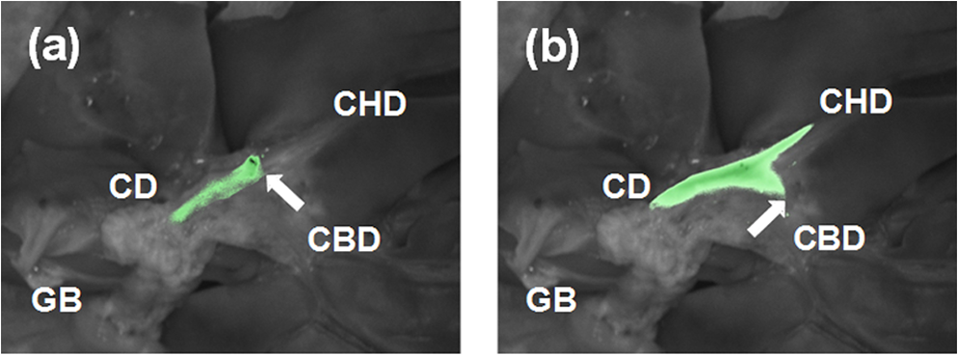
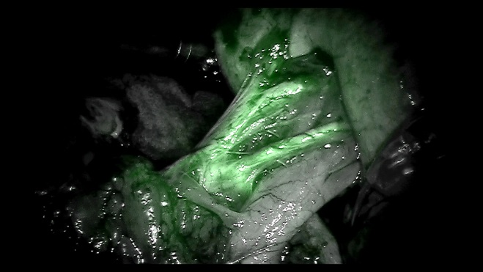
Other Advantages of Robotic Surgery
Firefly Fluorescence Imaging

Slide 22
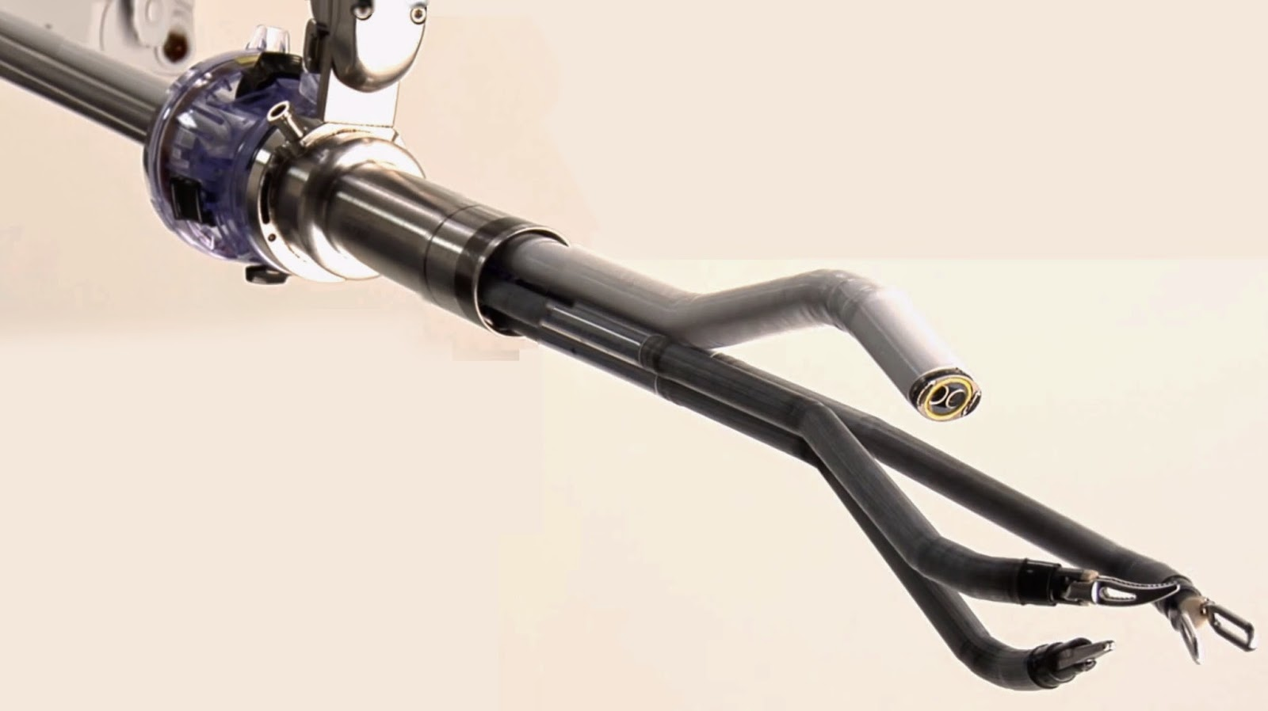
Future of Robotic Surgery

Slide 23
NOTES Surgery: Natural Orifice Translumenal Endoscopic Surgery
University centers
Orifice can be
Mouth (to stomach)
Vagina
Rectum

Slide 24
NOTES Surgery
Benefits
Cosmetic (No scars! Really no scars!)
Less pain
Faster recovery
Less risk of would infections and hernias
Disadvantages
Learning curve
Longer procedure time
Problems with closing enterotomies

Slide 25


Plagued by Hemorrhoids? Help is here…

Slide 26
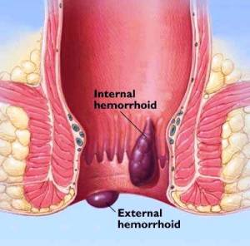
Minimally Invasive Hemorrhoid Treatment
Symptoms
Pain
Itching
Bleeding
Protrusion

Slide 27
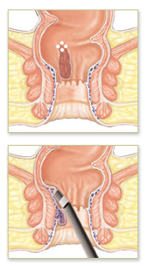
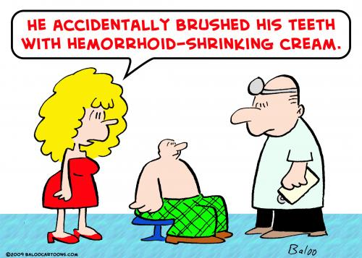
Hemorrhoid Treatment
Non-surgical treatment
Avoid constipation
Creams/ointments
Suppositories
Sitz baths
Diet modification

Slide 28
Hemorrhoid Treatment
Procedures
Rubber band ligation
PPH (stapled hemorrhoidectomy)
Hemorrhoidectomy

Slide 29
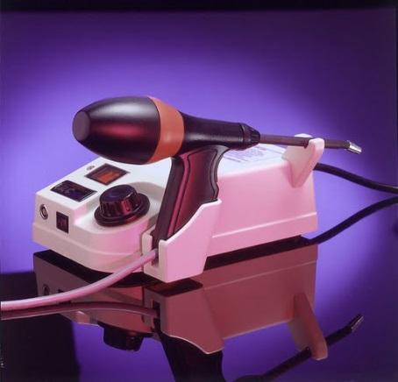

Minimally Invasive Hemorrhoid Treatment
Infrared Coagulation (IRC)
Safe
Quick (2 minutes)
Painless!
In-office treatment
Great results

Slide 30
Conclusion
There continues to be a push for more and more minimally invasive surgery.
Many patients (and healthcare professionals) are still not aware of the availability and benefits of MIS and robotic surgery.
The future of surgery will continue to see a move toward scarless surgery, advanced robotics.
We would be happy to see you in consultation to discuss any of these procedures: 716-677-5500

